Slide 1
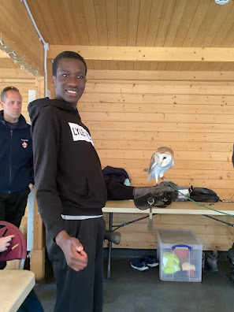
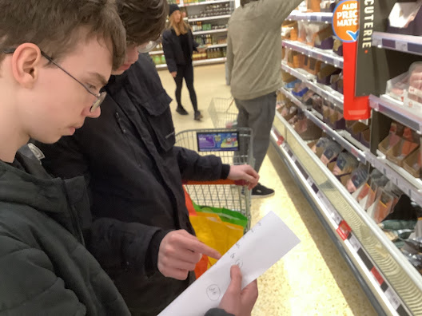
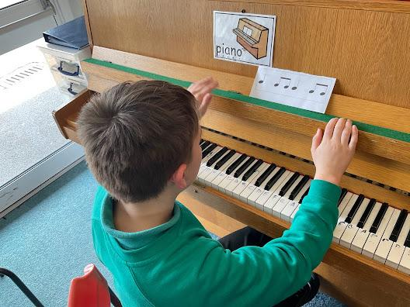
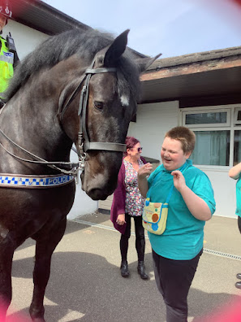

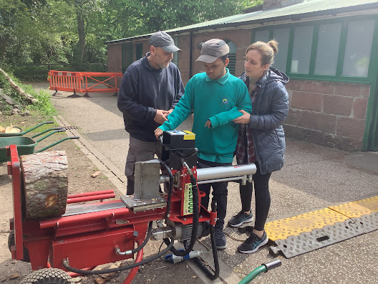
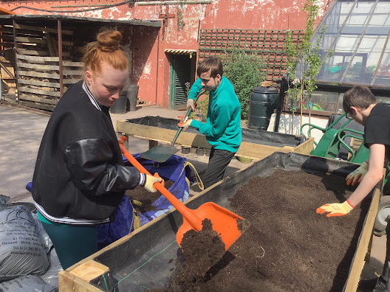
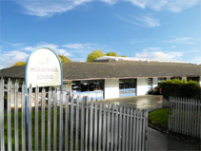
SEN Information Report
Click here

Slide 2

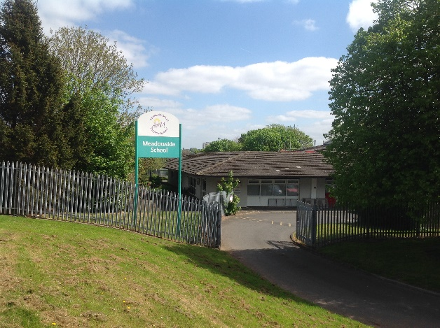

What should I do if I think my child may have special educational needs?
How will the curriculum be matched to my child’s needs?
What training are the staff supporting my child with SEND had or having?
How will staff support my child?
Click on a question to find out more information
How is the decision made about what type and how much support my child will receive?
How are your resources allocated and matched to my child’s needs?
How accessible is Meadowside School?
How will I know how my child is doing and how will you help me to support my child’s learning?
How will my child be included in activities outside the classroom, including educational offsite visits?
How will you know if my son/daughter needs extra help?
Can staff get extra help from experts outside if they need to?
How will Meadowside help with transitions to the school, initially and later?
What support will there be for my child’s overall well being?
What external specialist services and expertise are available or accessed at Meadowside?
Where can I get more information?

Slide 3

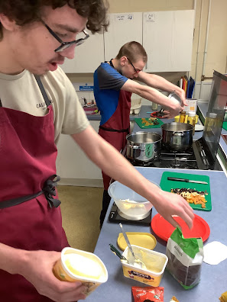

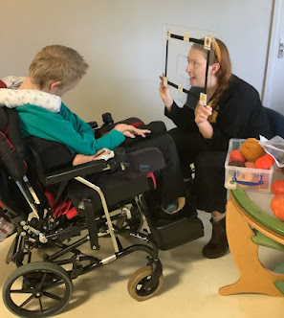
Meadowside staff, including teachers, teaching assistants and other staff have regular and up to date training in:
Team Teach, positive handling and behaviour management
Child Protection and Safeguarding, including PREVENT
Makaton – Foundation level
Autism
Moving and Handling
What training are the staff supporting my child with SEND had or having?
Some staff have additional specialist training in:
Rebound Therapy
Makaton – Advanced Level
Autism (Autism Education Trust)
Emergency Pool Response (EPR)
Team Teach – Tutor
Moving and Handling- Tutor
Defibrilator use
First Aid – deeper level
Next question
menu

Slide 4
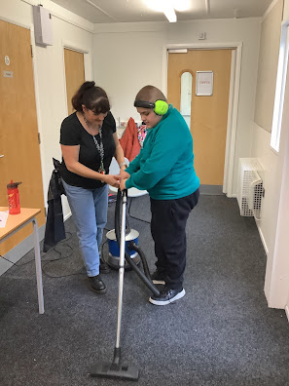
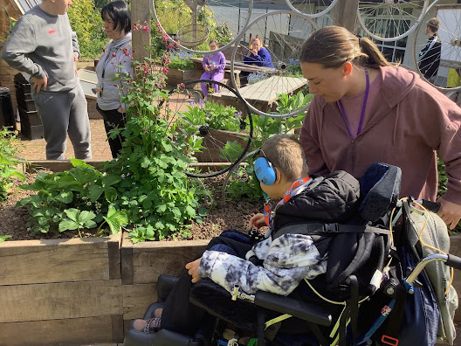
The Pastoral staff team, in consultation with parents will produce a PLIM (person learning intention map).
Curriculum coordinators are all qualified teachers who plan and prepare schemes of work, targets and individualised learning outcomes for every child. Interventions, such as 1-1 support, may take place for children not reaching expected targets.
The school has two Higher Level Teaching Assistants (HLTA) who lead and cover lessons under the supervision of teachers.
All pastoral classes are led by a qualified teacher and supported by 1 or more Teaching Assistants ranging from Level 1 to Level 3.
The Family Support Worker supports with Attendance and signposts families to further support.
How will staff support my child?
menu
Next question

Slide 5
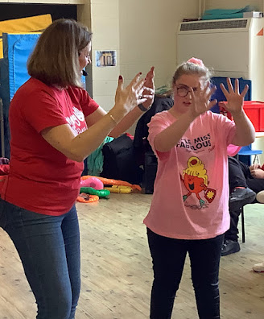
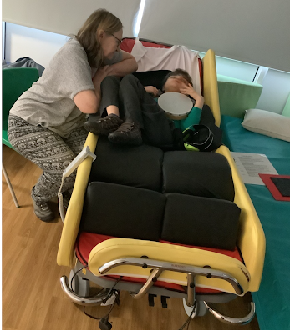
What should I do if I think my child may have special educational needs?
Speak to your child’s current school.
Contact your GP and request an assessment.
All children at Meadowside School have an EHCP (Education Health & Care Plan). If you feel that the EHCP requires amending, contact the Pastoral Tutor.
Next question
menu

Slide 6
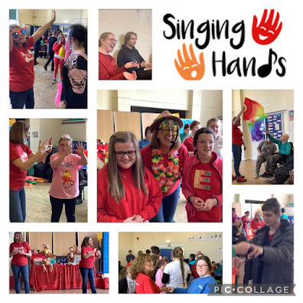


How will the curriculum be matched to my child’s needs?
All Curriculum coordinators set individual targets matched to each child.
The Pastoral Team will devise an individualised timetable, in consultation with parents and the Assistant Head Teachers.
A wide range of opportunities is available; some children access Woodchurch High School for inclusion in mainstream courses. Some children access work based learning opportunities in the community.
Curriculum enrichment through on site theatre events, musicians and sports coaches.
Next question
menu

Slide 7
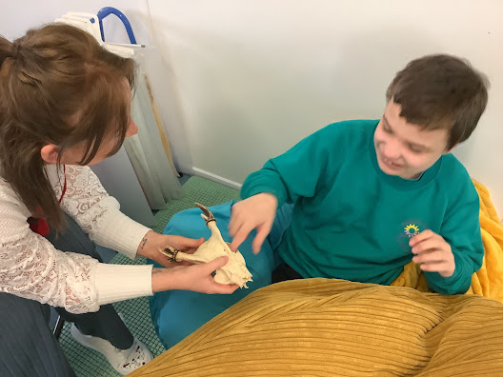
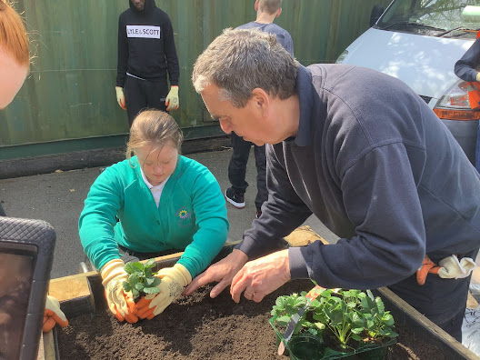
How is the decision made about what type and how much support my child will receive?
All decisions regarding support are on a need by need basis, in partnership with parents and other professional agencies as appropriate.
Pupil Premium funding is used to overcome any barriers to learning, such as: to improve behaviour, relationships, self-esteem or any health or therapy issues.
Next question
menu

Slide 8
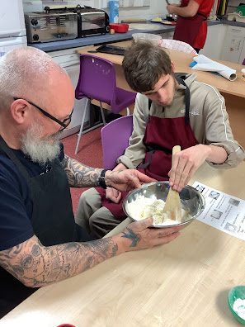
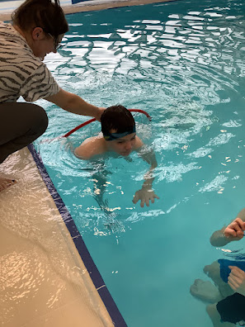
How accessible is Meadowside School?
Ground floor layout
Wheelchair accessible throughout
Hoisting in all changing rooms, the Medical room and the Preformal Classroom
Height adjustable tables available.
Height adjustable worktops/sink/cooker in the Life Skills classroom.
Swimming/hydrotherapy pool, fully accessible throughout
Next question
menu

Slide 9
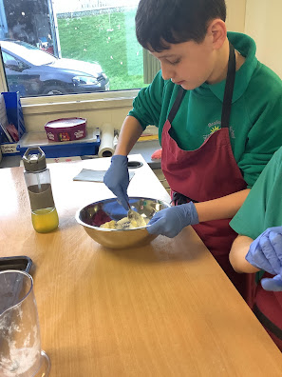


How will Meadowside help with transitions to the school, initially and later?
Transition from Primary School
Early liaison between Meadowside and Primary feeder schools.
Activities arranged for Year 6 children to access at Meadowside e.g. Taster afternoons including cookery, swimming or sports.
Activities to engage parents e.g. social events/workshops
Transition from Meadowside School
Links with the Independent Advice & Guidance adviser begin in the Year 9 Annual Reviews
Careers Fairs
Links with Wirral Metropolitan College/out of borough colleges/Social Care.
Careers lessons.
Next question
menu

Slide 10
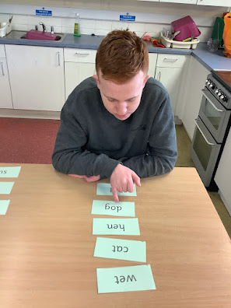
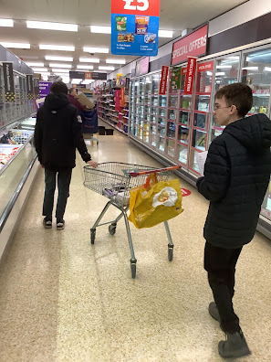
How will I know how my child is doing and how will you help me to support my child’s learning?
The Pastoral Team will liaise closely with you, by phone, via Class Dojo or by reporting progress in the Home School Book.
Termly opportunities for Consultation, with Subject Leaders, Pastoral Tutors or other professionals.
Special Events, such as our Showcase Day, where parents are invited in to join in with activities and talk to staff.
Parent workshops, covering topics such as e-Safety, Toileting, Personal Development.
Annual Report on progress, in addition to the Annual Review of the EHCP.
Next question
menu

Slide 11
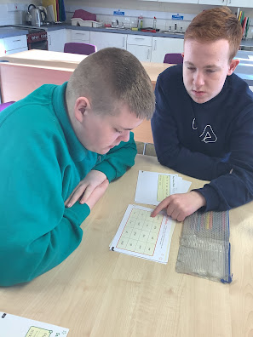
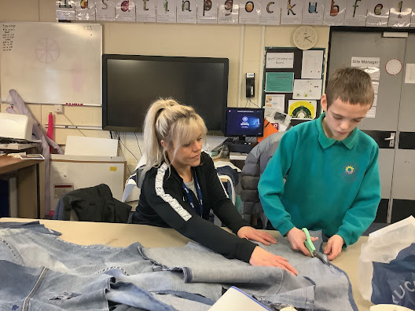
How will you know if my son/daughter needs extra help?
Ongoing assessment and monitoring, target setting and evaluation.
Close liaison with parents, addressing concerns and referring to other agencies as appropriate.
Effective use of classroom support, promoting independence in a structured environment.
Next question
menu

Slide 12

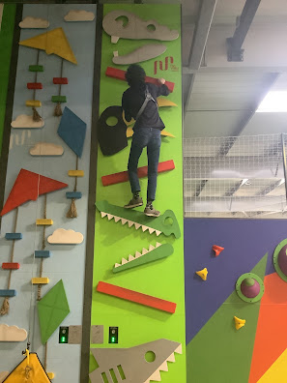
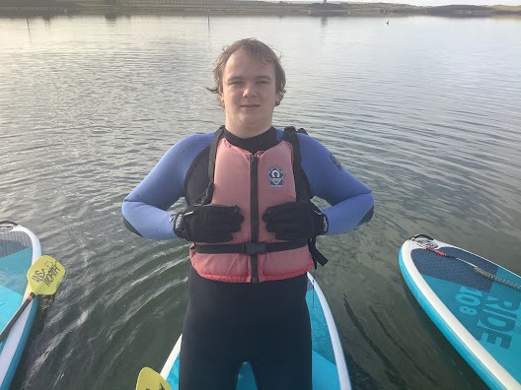
How will my child be included in activities outside the classroom, including educational offsite visits?
All learners have opportunities to access activities offsite.
All KS3 classes are encouraged to take part in offsite visits to places such as museums, local villages, farms and theatres.
We have year long placements with Crosby Lakeside Adventure Centre, Activities for All, Holy Cross Church Community Café and other community based opportunities.
Student Council members take part in many community based activities
Next question
menu

Slide 13
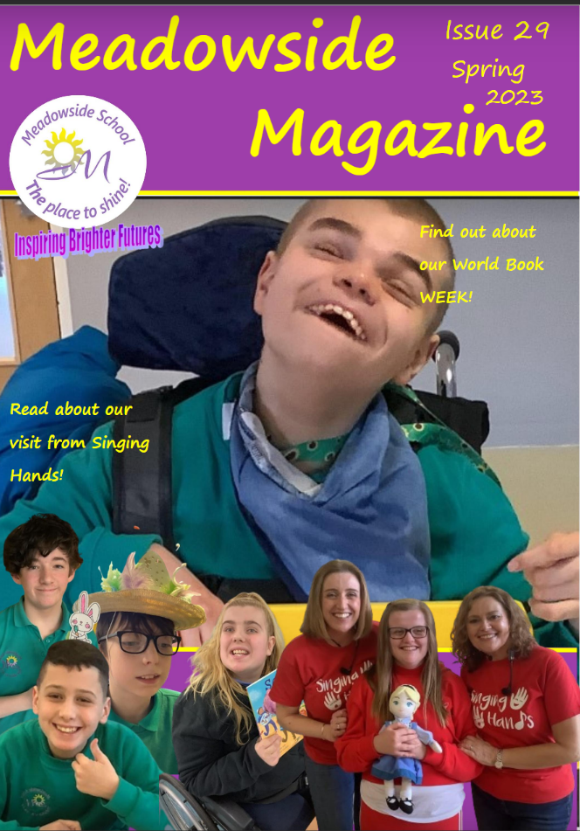

Where can I get more information?
Contact us to visit the school or speak to a member of staff – 0151 678 7711
Check out our website at www.meadowsideschool.com
Read the Meadowside Magazine
Facebook and Twitter pages
Next question
menu

Slide 14
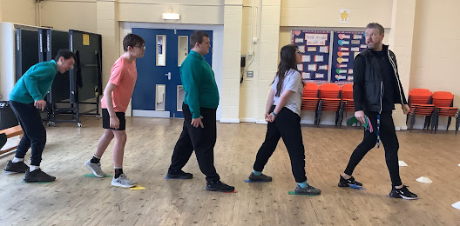
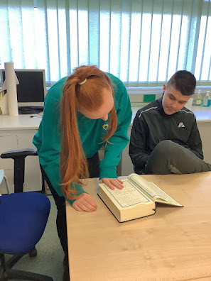
What support will there be for my child’s overall well being?
Regular events to develop social skills.
Pastoral teams build strong relationships with all children, identifying issues early and working together with parents to maintain a positive atmosphere and climate for learning.
The HLTAs will support children where necessary, working with the Response agency, part of Wirral Council Universal Youth Support Service.
Next question
menu

Slide 15
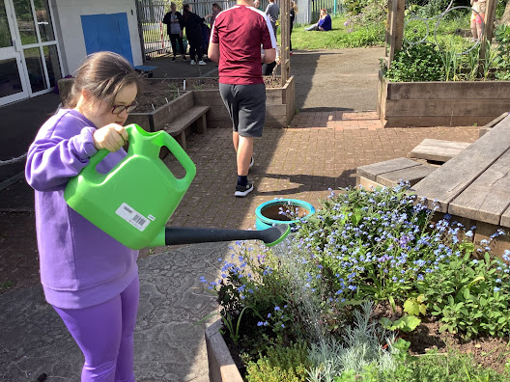
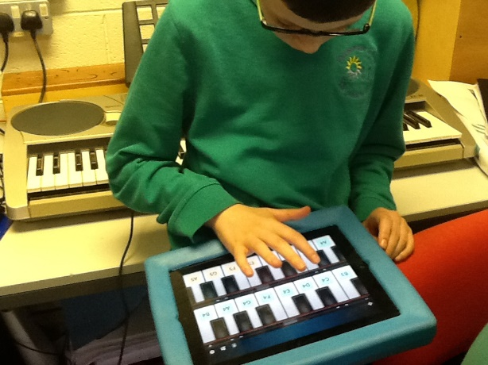
How are your resources allocated and matched to my child’s needs?
Curriculum coordinators develop long term plans with costings to develop the subjects over a projected term. Each subject area is allocated a budget and its effectiveness monitored by the Head Teacher.
Children who benefit from inclusion at Woodchurch High School are supported by a Teaching Assistant as appropriate.
Next question
menu

Slide 16

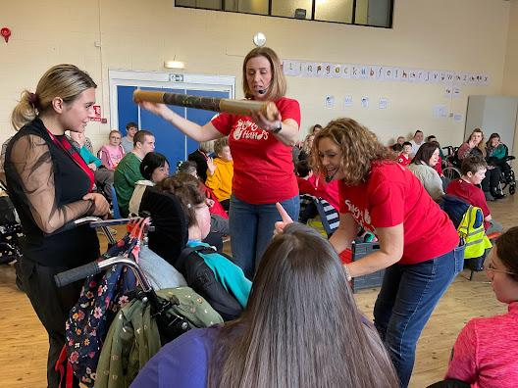

Can staff get extra help from experts outside if they need to?
Weekly session with the Riding for the Disabled Association (RDA)
We link to Music Mark supported by the local music Hub: Musical Routes
We achieved Silver Artsmark, in 2025
Links with Everton in the Community
Links with Merseyside SLD Schools consortium
Weekly PSHE input from Health Services in Schools (HSIS)
Fortnightly on site SHINE therapist
Next question
menu

Slide 17
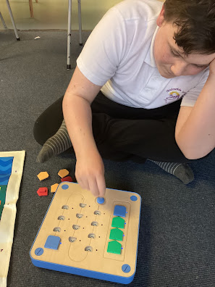

What external specialist services and expertise are available at Meadowside?
NHS nursing team on site
Physiotherapist regularly on site
WiSCH - Wirral Services for Child Health work closely with young people who have additional health care needs.
SaLT - Wirral Speech and Language Therapy
The Educational Psychology Service
CAMHS – Child and Mental Health Service
LDT – the Learning Disabilities Team
SHINE- Specialised Sensory Therapists
Cover slide
menu

