Slide 1
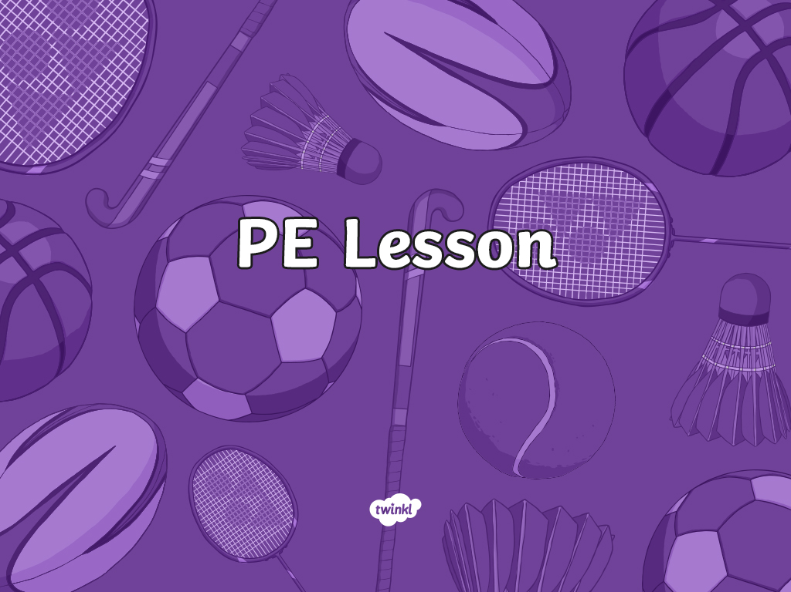

Slide 2
Aim
I can listen to commands and follow instructions.
Success Criteria
I can demonstrate my understanding of instructions in French.
I can follow instructions when I hear them.

Slide 3



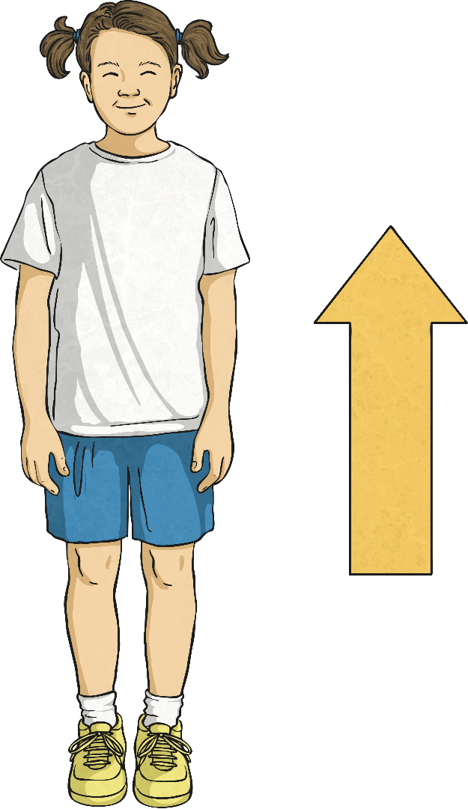
Levez-vous

Slide 4
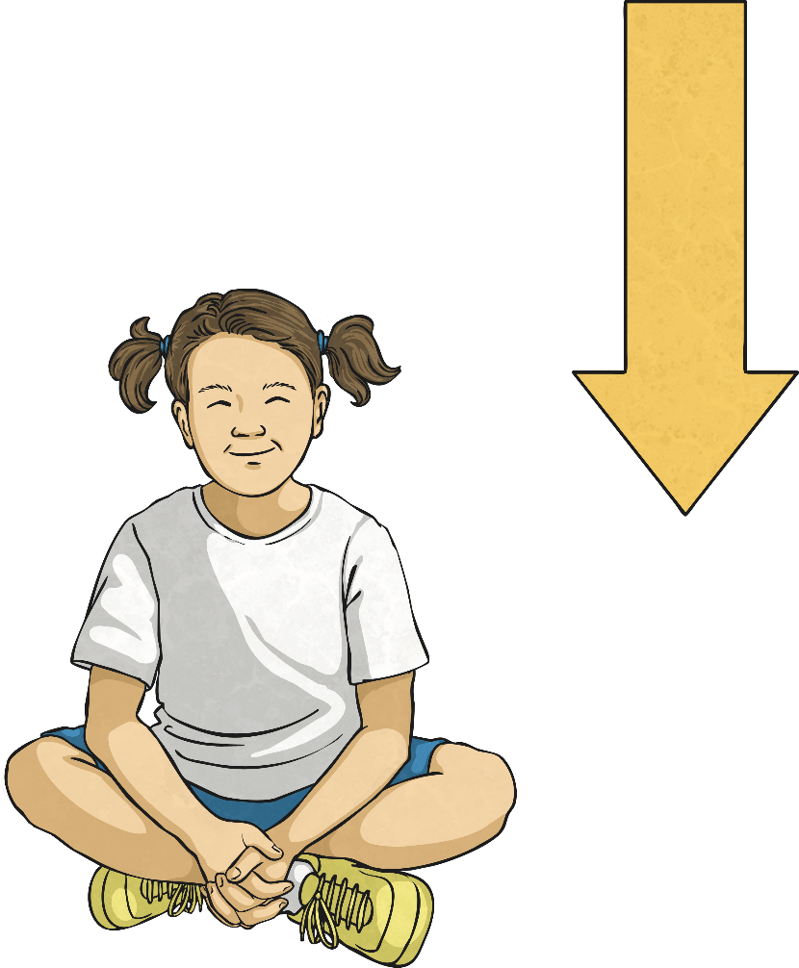
Asseyez-vous

Slide 5

Arrêtez

Slide 6
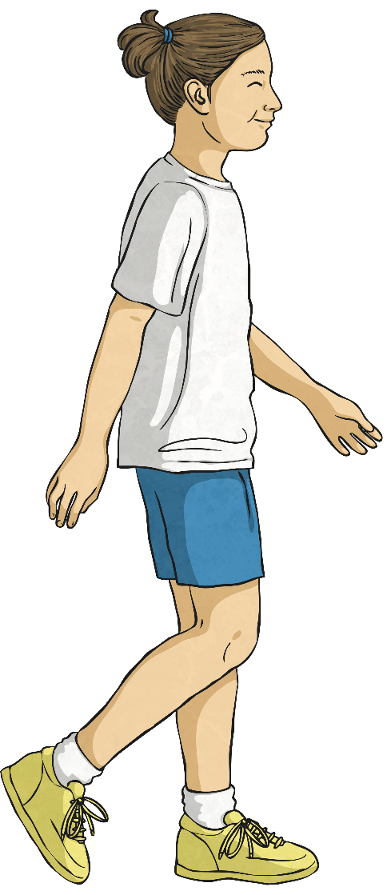
Marchez

Slide 7
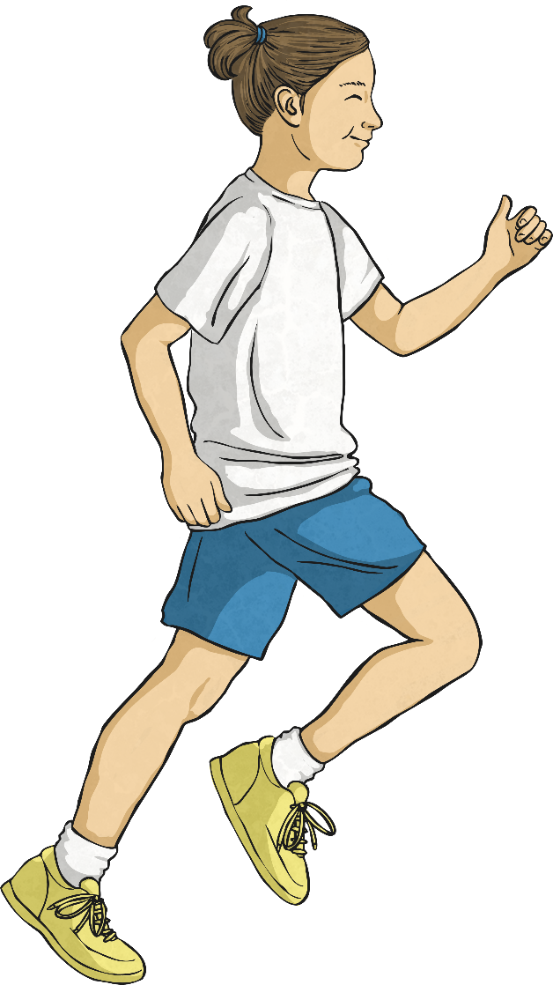
Courez

Slide 8
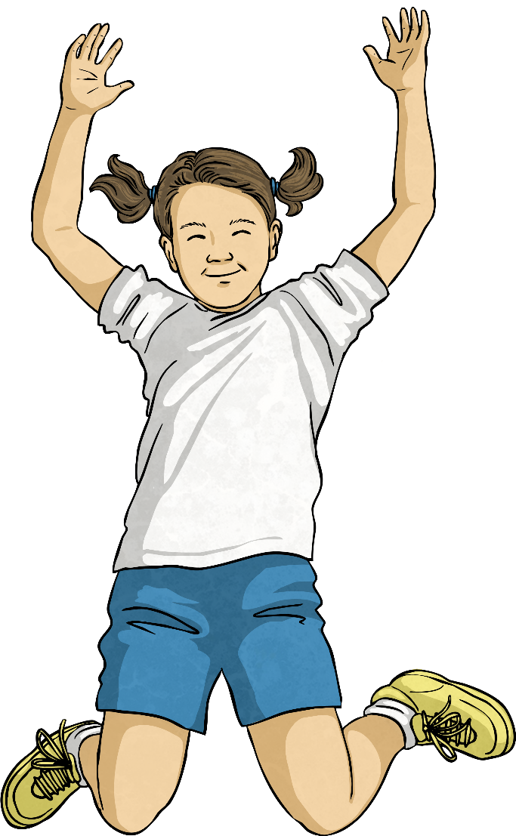
Sautez

Slide 9
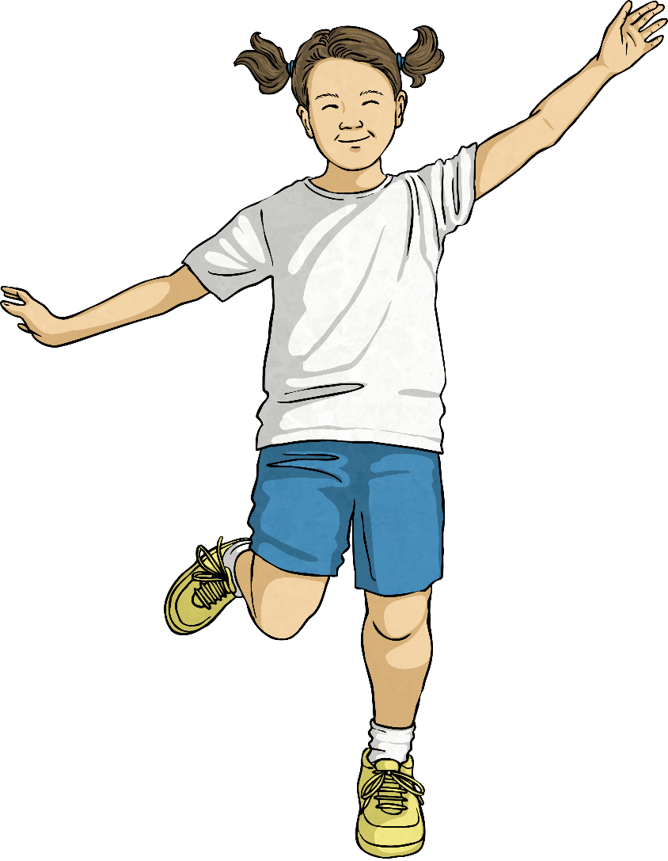
Sautez à cloche-pied

Slide 10
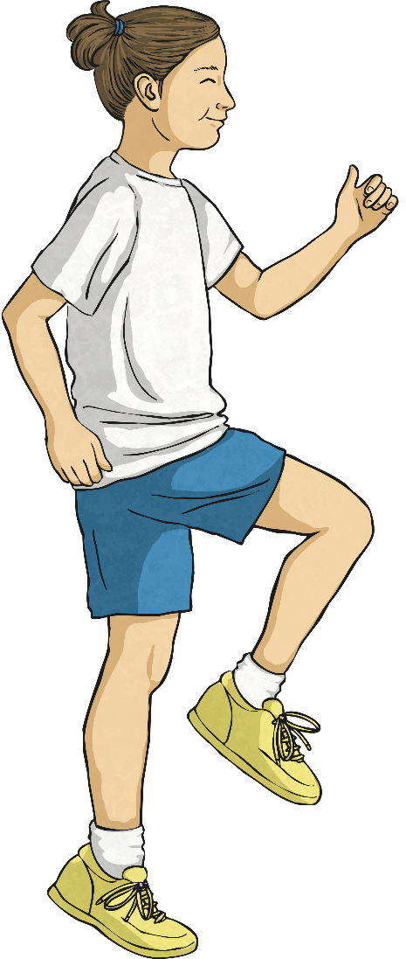
Courez sur place

Slide 11
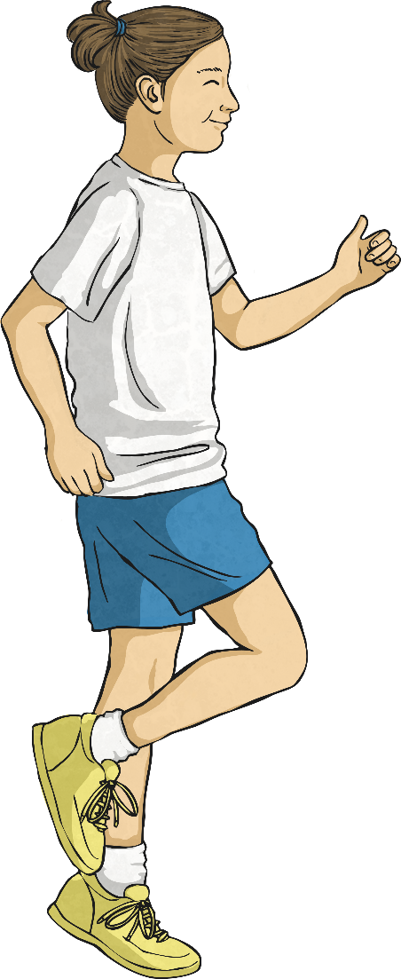
Sautillez

Slide 12

Aim
I can listen to commands and follow instructions.
Success Criteria
I can demonstrate my understanding of instructions in French.
I can follow instructions when I hear them.

